Slide 1
Software testing introduction
Define software testing
Importance of testing
Roles and Responsibilities
Principles of software testing
Define Quality
How much testing is enough?
Differences between Manual and Automation Testing

Slide 2

Define Testing
Testing: software testing is defined as an activity to check whether the actual results match the expected results and to ensure that the software system is Defect free.
Testing is about providing a quality product to the customer Quality in terms of usage Quality in terms of look and feel Quality in terms of data integrity Quality in terms of security

Slide 3


Testing is about ideas
application can be tested in many ways.
everyone will propose a different approach and idea
as a tester must analyze and pick the most suitable approach
some cases a planned testing is very much required
few cases random/ad-hoc testing helps to uncover issues
Evaluation of approaches should be done prior to testing

Slide 4
Define Quality
Definition: Quality software is reasonably bug or defect free, delivered on time and within budget, meets requirements and/or expectations, and is maintainable.
Key aspects of quality for the customer include:
Good design – looks and style
Good functionality – it does the job well
Reliable – acceptable level of breakdowns or failure
Consistency
Durable – lasts for long time
Good after sales service
Value for money

Slide 5

Responsibilities of Test Lead/Manager
Test lead/manager: A test lead is responsible for:
Defining the testing activities for subordinates – testers or test engineers.
All responsibilities of test planning.
To check if the team has all the necessary resources to execute the testing activities.
To check if testing is going hand in hand with the software development in all phases.
Prepare the status report of testing activities.
Required Interactions with customers.
Updating project manager regularly about the progress of testing activities.

Slide 6
Responsibilities of Test Engineer
Test engineers/QA testers/QC testers are responsible for:
To read all the documents and understand what needs to be tested.
Based on the information procured in the above step decide how it is to be tested.
Inform the test lead about what all resources will be required for software testing.
Develop test cases and prioritize testing activities.
Execute all the test case and report defects, define severity and priority for each defect.
Carry out regression testing every time when changes are made to the code to fix defects.

Slide 7
Software Testing Principles
Testing Shows the Presence of Defects – it’s not 100% defect free
Early Testing – Defect fix cost increases
Exhaustive Testing- It’s not Possible (example: Rediff mail account)
Testing is Context-Dependent – testing a banking application is different than testing any e-commerce
Defect Clustering - 80% of the problems are found in 20% of the modules
Pesticide Paradox - test cases needs to be regularly reviewed and revised
Absence of Error - testing is performed on wrong requirements

Slide 8
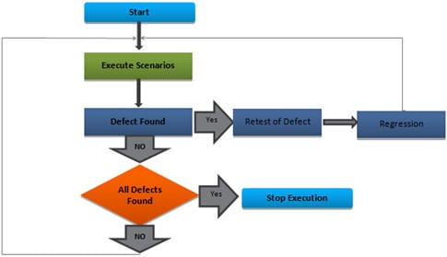
When to stop testing

Slide 9
When to use manual Testing?
Manual Testing prevails when cognitive and behavioral abilities are required to test the software.
Functionalities
User Interface (UI)
User Experience (UX)
Website & App Behavior
Features
User Acceptance

Slide 10
What is Automation Testing?
Automation testing uses frameworks to run tests. Each framework is scripted with the rules of automation pertaining to the software to be tested. This framework is integrated with the various components like
function libraries,
test data sources,
object details
other reusable modules

